Slide 1
Week 6
COGS 108 SP 2026
*By: Jason Chen & Jessica Cheng, Spring 2026

Slide 2
Due dates
A2: Wednesday (05/06)
D5: Friday (05/08)

Slide 3
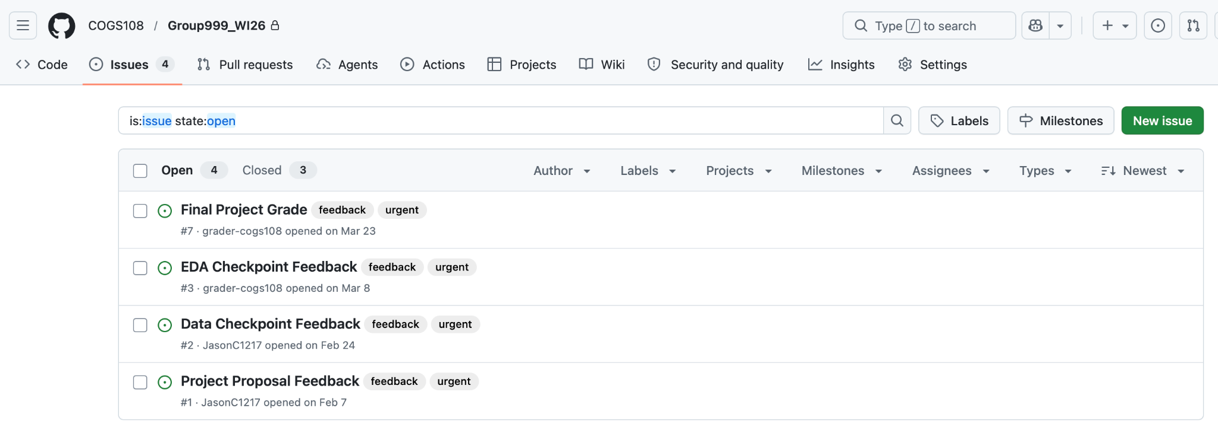
Project Proposal
Feedback will be out by the end of today
Make revisions in next checkpoint
You can find your feedback in your group GitHub repository under Issues, in an issue titled “Project Proposal Feedback.”

Slide 4
Null-hypothesis significance testing
Focus on the logic chain, not just the final p-value.
H₀ / H₁
Statistic
Null model
p-value
Decision
Define the comparison
Summarize evidence
What would happen by chance?
Tail-area evidence
Report + interpret
Reminder
For any scenario, try to state the null hypothesis, what statistic would be computed, what “more extreme” means, and what conclusion would be justified.
Notes:
Null-hypothesis significance testing starts with a null hypothesis and an alternative hypothesis.
The null hypothesis usually represents no difference, no association, or no effect. The alternative represents the pattern we are looking for evidence against the null.
Then we compute a test statistic. This statistic summarizes how far the observed data are from what we would expect under the null model.
The p-value is interpreted under the assumption that the null hypothesis is true. It asks how unusual the observed result, or a more extreme result, would be if the null model generated the data.
The key point is that NHST is a conditional reasoning framework. We are not directly calculating the probability that the null hypothesis is true.

Slide 5
p-values, α, and practical importance
Significance and importance answer different questions.
statistical evidence ≠ effect magnitude
effect size + uncertainty = interpretation
p-value thinking
Effect-size thinking
Uncertainty thinking
Ask: “How surprising would this statistic be if the null model were true?” Keep the conditioning clear.
Ask: “How large is the estimated difference or relationship in the units of the problem?”
Ask: “How much sampling variability is around the estimate?” Use intervals and standard errors as context.
Reminder
Practice explaining a result using all three lenses without making causal claims that the design cannot support.
Notes:
A p-value tells us about statistical evidence, but it does not tell us how large or important an effect is.
A small p-value can happen when the effect is large, but it can also happen when the sample size is large and the effect is very small.
That is why we also need effect size. Effect size describes the magnitude of the difference or relationship in a more interpretable way.
We also need uncertainty, often represented by a standard error or confidence interval. This helps us understand how precise the estimate is.
When interpreting results, try to separate three things: statistical evidence, practical importance, and uncertainty.

Slide 6
p-values, α, and practical importance
Significance and importance answer different questions.
Confidence Interval
α
Interpretation
CI = 1-α
The percentage of times that a computed interval is expected to contain the true population parameter if sampling is repeated
The probability of being wrong for a confidence level
A 95% confidence interval implies that if we take 100 samples and compute 100 intervals, we expect roughly 95 of them to contain the true population mean

Slide 7
Choosing a two-group comparison
Start from the data structure before naming a test.
Outcome type
continuous • ordinal/rankable • categorical
Group relationship
independent samples • repeated/paired samples
Distribution shape
roughly symmetric • skewed • outlier-heavy
Variance pattern
similar spread • very different spread
Scientific target
mean difference • rank/location shift • full distribution
Reminder
In review, practice choosing the family of methods first; only then decide the exact test and interpretation.
Notes:
For a two-group comparison, start with the structure of the data.
Ask whether the outcome is continuous, ordinal, categorical, or rankable. Then ask whether the groups are independent or paired.
For example, two independent groups require different reasoning than repeated measurements from the same people.
Next, inspect the shape of the data. Are the distributions roughly symmetric? Are there strong outliers? Is one group much more variable than the other?
The scientific target also matters. Sometimes we care about comparing means. Other times we care about rank differences, medians, or the entire distribution.
The test should follow from the data structure and the question being asked.

Slide 8
t-test assumption audit
Parametric tests can be powerful, but only when the setup is plausible.
Before trusting a t-style comparison, inspect:
• Are observations independent within and across groups?
• Is the outcome measured on a scale where means are meaningful?
• Are the distributions approximately compatible with the model?
• Are extreme outliers or strong skew likely to dominate the mean?
• Is the spread of the groups similar enough for the chosen variant?
Compare centers only after checking the shape of the data.
Use visual diagnostics as part of the reasoning, not as decoration.
Notes:
A t-test is a parametric method, meaning it relies on assumptions about the data and sampling process.
Before trusting a t-test-style comparison, check that the observations are independent. This is one of the most important assumptions.
Also check whether the outcome is measured on a scale where means are meaningful. A t-test compares means, so the mean needs to be interpretable.
Then check distributional shape. Mild deviations from normality may be acceptable, especially with reasonable sample sizes, but strong skew or extreme outliers can be a problem.
Variance also matters. If the groups have very different spreads, the standard Student’s t-test may not be the best version of the test.
The broader lesson is that visual diagnostics and assumption checks should come before interpretation.

Slide 9
More than two groups and multiple testing
Repeated pairwise tests change the error-rate story.
When there are several groups, ask:
α
Global question
Is there evidence of any group-level difference?
× comparisons
Pairwise question
Which specific groups differ from each other?
controls false positives
Error-rate question
How many comparisons are being made?
planned workflow
Follow-up question
What correction or post-hoc plan is appropriate?
Notes:
When there are more than two groups, the question changes.
A global question asks whether there is evidence that at least one group differs from the others.
A pairwise question asks which specific groups differ from each other.
If we run many pairwise tests, the chance of getting at least one false positive increases. This is the multiple-comparisons problem.
That is why multiple-group settings often require a global test, a correction strategy, or a planned post-hoc testing procedure.
The main thing to remember is that more comparisons change the error-rate story.

Slide 10
Transformations and rank-based inference
When model assumptions are strained, change the representation or the method.
Two review moves
log(y)
Transformation logic
A transformation can make a skewed variable easier to model and can change how differences are interpreted.
rank(y)
Rank-based logic
Rank methods reduce reliance on Normal-model assumptions by analyzing ordering information rather than raw magnitudes.
Reminder
Practice saying what information is preserved and what information is changed when you transform or rank the data.
Notes:
Sometimes the raw data do not fit the assumptions of a parametric method very well.
One option is transformation. A log transformation is often used when data are strongly right-skewed or when values vary across orders of magnitude.
A transformation can make the distribution easier to model, but it also changes the interpretation. Differences on the log scale are not interpreted the same way as differences on the original scale.
Another option is a rank-based method. Rank-based methods analyze the ordering of observations instead of their raw numerical distances.
This can make the analysis less sensitive to extreme outliers or strong skew, but it also means we are no longer making exactly the same claim as a mean-based test.

Slide 11
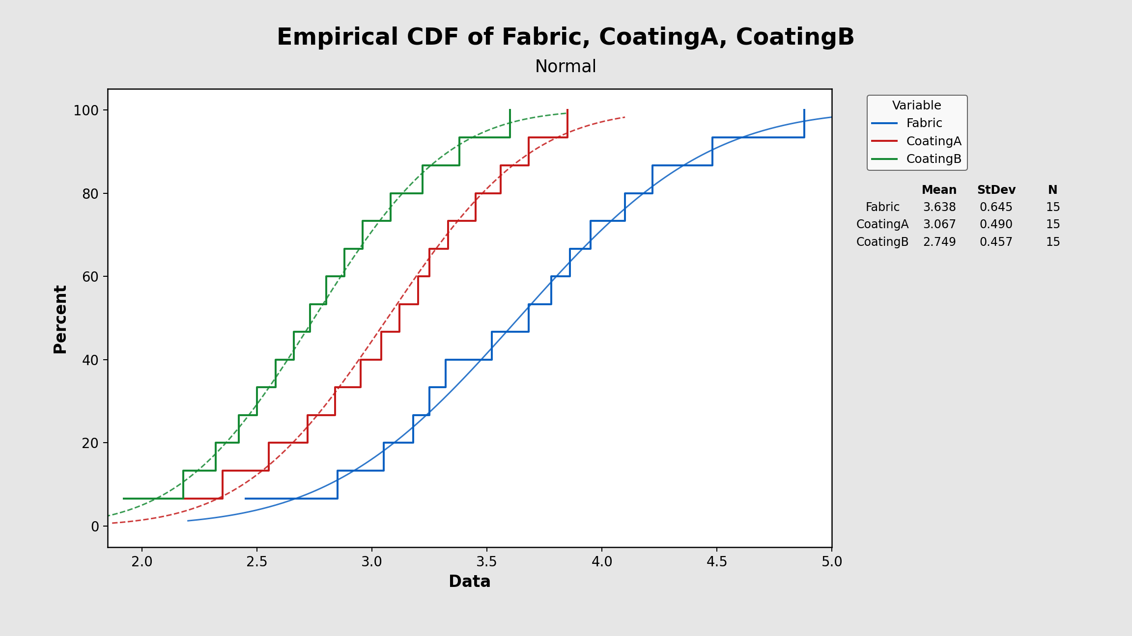
Distribution-level comparisons
Some questions are about the whole distribution, not only the mean.
KS-test reasoning
A distribution-comparison test asks whether two empirical CDFs look compatible with the same underlying distribution.
Score-model context
For model probability scores, ask whether the two models produce similar score distributions across users.
Reminder
Practice distinguishing “different average score” from “different score distribution.”
Notes:
Some questions are not just about whether two groups have different means.
Sometimes we want to know whether two entire distributions differ.
A cumulative distribution function, or CDF, shows the proportion of observations less than or equal to each value.
A distribution-level test compares the shapes of empirical distributions. This can capture differences in location, spread, skew, or other distributional features.
This is especially relevant when comparing model scores, such as predicted probabilities from two algorithms.
The key distinction is: a mean comparison asks about average behavior, while a distribution comparison asks about the overall pattern of values.

Slide 12
Spatial data: patterns and aggregation traps
Spatial summaries depend on scale, boundaries, and dependence.
Average nearest neighbor / clustering
MAUP
Changing geographic units can change the apparent pattern.
Ecological fallacy
A group-level pattern may not describe individuals.
Autocorrelation
Nearby or adjacent observations may not be independent.
Ask whether points are clustered, dispersed, or random — and at what scale.
Boundary design
Political or administrative boundaries can encode incentives.
Notes:
Spatial data introduce additional complications because observations are located in space.
One issue is clustering. Points may be tightly clustered, dispersed, or approximately random, depending on the scale of analysis.
Another issue is the modifiable areal unit problem, or MAUP. This means that changing the geographic boundaries or aggregation units can change the apparent pattern.
The ecological fallacy is another risk. A relationship observed at the group or regional level may not hold for individuals.
Spatial autocorrelation is also important. Nearby observations may be more similar to each other than distant observations, which can violate independence assumptions.
So with spatial data, always ask how geography, boundaries, and dependence affect the analysis.

Slide 13
OLS regression: what the line is doing
A fitted line summarizes a conditional relationship.
y = β₀ + β₁x + ε
β coefficient
Direction and magnitude of the estimated relationship, conditional on the model.
Standard error
Sampling uncertainty around the coefficient estimate.
Confidence band
Uncertainty around the fitted mean relationship, not the full range of outcomes.
Notes:
Ordinary least squares regression fits a line that summarizes the relationship between a dependent variable and one or more predictors.
In a simple linear model, the slope coefficient describes the estimated change in the outcome associated with a one-unit change in the predictor.
The sign of the coefficient tells us the direction of the relationship. The magnitude tells us the size of the relationship in the units of the model.
The standard error tells us how uncertain the coefficient estimate is.
The shaded band often shown around a regression line is usually a confidence interval for the estimated mean relationship. It is not the full range of possible y-values.
The line is a model summary, not proof of causation by itself.

Slide 14
Model fit versus model complexity
Adding predictors changes both fit and penalty-based metrics.
R²
adjusted R²
BIC
Raw fit
Fit with a predictor penalty
Information criterion
How much variation is explained by the fitted values?
Does the new predictor improve the model enough to justify its complexity?
Compare candidate models while accounting for likelihood and parameter count.
Reminder
Practice predicting the direction each metric might move when you add useful versus irrelevant predictors.
Notes:
Model evaluation is not only about whether a model fits the current data well.
R-squared measures how much variation in the outcome is explained by the fitted model. But R-squared can increase when predictors are added, even if those predictors are not truly useful.
Adjusted R-squared accounts for the number of predictors, so it penalizes unnecessary complexity.
BIC is another model comparison metric. It balances model fit against the number of parameters, with a stronger penalty for complexity.
The key question is whether a new predictor improves the model enough to justify making the model more complicated.
More predictors do not automatically mean a better model.

Slide 15
OLS diagnostics and failure modes
A good-looking line is not enough.
Linearity
Mean relationship is represented by the model form.
Independence
Residuals are not correlated across observations.
Homoscedasticity
Residual spread is roughly stable across fitted values.
Collinearity
Predictors do not duplicate each other’s information.
Time series caution
Sequential observations may carry memory from prior time points.
Condition number
diagnostic clue, not a conclusion by itself
Notes:
A regression line can look reasonable but still violate important assumptions.
Linearity means the model form should reasonably describe the mean relationship between predictors and the outcome.
Independence means residuals should not be correlated with each other. This can be violated in time series, repeated measures, or spatial data.
Homoscedasticity means the residual spread should be roughly stable across fitted values. If the residual spread changes dramatically, standard errors and inference can be affected.
Collinearity occurs when predictors contain overlapping or redundant information. This can make coefficient estimates unstable and difficult to interpret.
A high condition number can be a warning sign for collinearity or scaling issues, but it should be interpreted as a diagnostic clue rather than a final conclusion.

Slide 16
Quiz Time
NO Phone, NO Communication, No Notes
Access Code: springsteen

Slide 17
Your time to …
Work on projects
Finish A2
Finish D5
Have fun...

